Slide 1
Graphs Challenge Eulerian Circuit
Practice using Graphs in a more challenging problem.

Slide 2
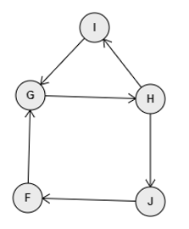
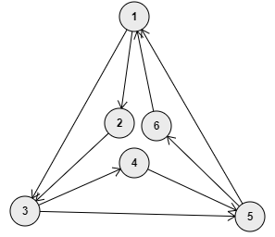
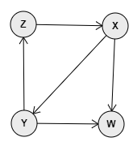
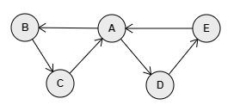












the Eulerian Circuit definition
Formal definitions: Wikipedia Eulerian Path More digestible definitions: Euler Circuit in a Directed Graph
TLDR:
Eulerian Path is a path in graph that visits every edge exactly once. Eulerian Circuit is an Eulerian Path which starts and ends on the same vertex.
A graph is said to be an Eulerian Graph if it has an Eulerian Circuit.
eulerian1.txt
eulerian2.txt
eulerian3.txt
eulerian4.txt
IS Eulerian:
It has a circuit, starting and ending at A.
It traverses all edges: A > B > C > A > D > E
IS NOT Eulerian:
It has a path: H > I > G > H > J > F
But it does not start and end in the same node
IS NOT Eulerian:
Once traversing an edge reaching W there is no way further.
IS Eulerian:
It has a circuit starting and ending at 1
It traverses all edges: 1 > 2 > 3 > 4 > 5 > > 1 > 3 > 5 > 6 > 1
How to check if a directed graph is Eulerian?
A directed graph has an Eulerian Circuit if following conditions are true:
Is connected: can reach from each node every other node.
The inDegree is equal to the outDegree for every node.
The challenge:
Determine not only if a graph is Eulerian, but if it is, also determine a valid Eulerian circuit, listing the nodes of the graph in the order in which they can be travelled to form the circuit.

Slide 3
the Eulerian Circuit implementation
As the graph is traversed, it is important to track which edges were traversed, and which were not.
This can be done by:
Node.getPath(targetNode) → list of nodes (data) in the path from this to targetNode
create a path list initialized to null
foreach node in the _unvisited queue do
remove node from queue
if node is targetNode then
path ← create new empty list // base case: reached the target!
else
path ← node.getPath(targetNode) // recursive call
endIf
if path is not null then
add this._data as the first element in the path list
break;
endIf
add node back in the _unvisited queue // edge to node didn’t reach the target
endForEach
return path
○
Having the Node class contain all nodes that can be reached from this into an unvisited queue.
The unvisited queue of every node should be re-initialized from Node’s _edges each time the graph needs reseting.
When traversing recursively from this node, explore only the unvisited nodes.
When this node is traversing to a neighbor node, the neighbor is removed from this node’s unvisited queue. This is equivalent to marking the neighbor as “visited” and avoid infinite recursion.
Add a method to the Node class to return a valid path from the node itself to a target node given as parameter. To test it, add a similar capability to the Graph class, to return a valid circuit from a node’s data given as parameter.
Node.getPath(targetNode) → list of nodes (data) in the path from this to targetNode
Use the above, to implement the Graph’s getEulerianCircuit() method, with this behaviors:
Graph.getEulerianCircuit() → list of nodes (data) in the eulerian circuit
if Graph is not Eulerian then
return null
endIf
create a new, empty circuit list
if Graph has nodes then
add the data value of the first node to the circuit list
endIf
foreach data value in circuit do
get the node for that data
if node has unvisited neighbors then
cycle ← node.getPath(node)
insert cycle in the circuit, at the current position of data
endIf
endForEach
return circuit
○
If Graph is not Eulerian → returns null.
If Graph contains no nodes → returns an empty list of node data values.
Otherwise → returns the list of nodes in the Eulerian path, given by their data.
Graph.getEulerianCircuit() → list of nodes (data) in the Eulerian circuit

